Slide 1
Take Notice: Part Two
Savouring
Moving towards the Human Being
Notes:
Noticing the world around is hugely beneficial – massively associated with positive wellbeing. But what about noticing ourselves and our lives and our spiritual/religious practice.

Slide 2
What are we thinking of?
Moving from Human Doing to Human Being
From Martha to Mary?
Has our spiritual life become more about “doing” than “being”?
What can help?

Slide 3
Evangelii Gaudium, Nov 2013
And so the biggest threat of all gradually takes shape: “the grey pragmatism of the daily life of the Church, in which all appears to proceed normally, while in reality faith is wearing down and degenerating into small-mindedness”. A tomb psychology thus develops and slowly transforms Christians into mummies in a museum.
For all this, I repeat: Let us not allow ourselves to be robbed of the joy of evangelization!
Chapter 2, para 83
Notes:
Apostolic exhortation.
One of the very first published works by Francis and some pretty challenging stuff for all Catholics.
I was drawn by this idea of grey pragmatism where our daily practice becomes “normal” and we lose the fire in our bellies/hearts.
“Did not our hearts burn within us as he talked to us on the road…” (Luke 24:32); yes, and following prescribed health and safety protocols we put it out so as no one would get hurt!!
Is Francis concerned that we will stop noticing the beauty of our scripture and religious practice? Do we forget? Thoughts and discussion.

Slide 4
Doing v Being (mindful.org 2016)
Doing Mode
Being Mode
external world—to make a meal, build a house, or travel to the moon
internal world of self—to feel happy, not make mistakes, never be depressed again, or be a good person
the “discrepancy monitor”
the mind has “nothing to do, nowhere to go” and can focus fully on moment-by-moment experience, allowing us to be fully present and aware of whatever is here, right now
there is no goal or standard to be reached, and no need to evaluate experience in order to reduce discrepancies between actual and desired states
Notes:
Is all “proceeding normally” as we do, do, do? When do we wait and do …..nothing. Or we let go of the doing mode and have a different attitude.
Is either of these modes more important than the other or is the real trick how to get the balance right? Maybe the dial has too much towards “doing” in our modern lives.

Slide 5
Letting Go of Doing is not about not doing things. It is about letting go of the doing mode of consciousness - the attitude we bring to our doing.

Slide 6
Yongey Mingyur Rinpoche
Notes:
Do we have the habit of bringing the Doing mode into our Spiritual practice and struggle to find time for the Being mode. How might we enhance the being mode?
I love this man – I love the way he normalises meditation. Don’t be too hard on yourself if it’s not straightforward. These things ebb and flow. Getting in touch with ourselves and God is more about finding the time and exploring than meeting prescribed targets and doing, doing, doing.

Slide 7
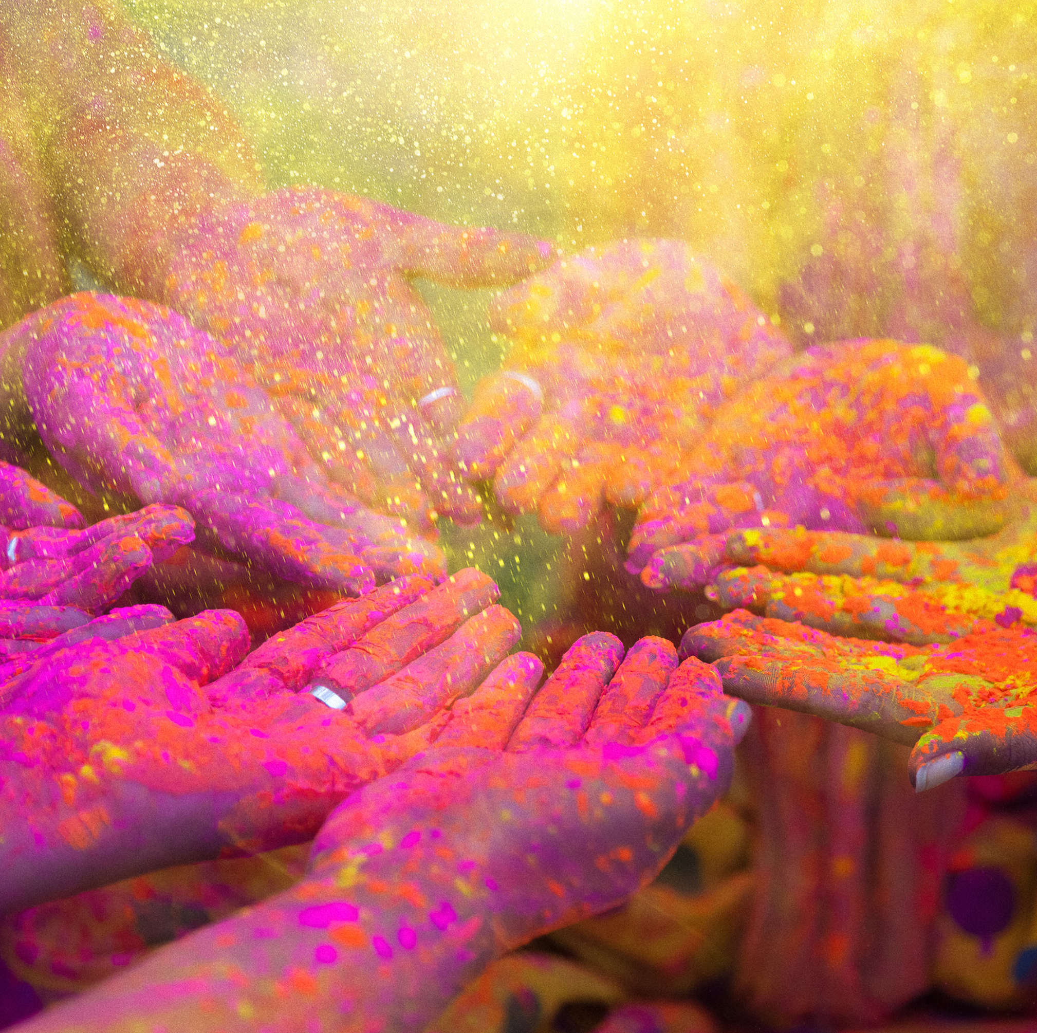
What does Five Ways say again…..?
Catch sight of the beautiful. Remark on the unusual. Notice the changing seasons.
Savour the moment, whether you are walking to work, eating lunch or talking to friends.
Notes:
Let’s think about SAVOURING.
One way of noticing the world around us is by putting time aside to savour our experiences.

Slide 8
Charlie and the Chocolate Factory
Notes:
I think Roald Dahl really got to the essence of savouring.
Get some chocolate and eat it really slowly while reading this.
In the session someone read this while everyone savoured their small(ish) piece of chocolate. MMMM – nice!!

Slide 9
Only once a year, on his birthday, did Charlie ever get to taste a bit of chocolate. The whole family saved up their money for that special occasion, and when the great day arrived, Charlie was always presented with one small chocolate bar to eat all by himself. And each time he received it, on those marvellous birthday mornings, he would place it carefully in a small wooden box that he owned, and treasure it as though it were a bar of solid gold; and for the next few days he would allow himself only to look at it, but never to touch it. Then at last when he could stand it no longer, he would peel back a tiny bit of the paper wrapping at one corner to expose a tiny bit of chocolate, and then he would take a tiny nibble – just enough to allow the lovely, sweet taste to spread out slowly over his tongue. The next day he would take another tiny nibble, and so on, and so on. In this way Charlie would make his sixpenny bar of birthday chocolate last him for more than a month.
In the town where Charlie lived there was an enormous chocolate factory. It was Wonka’s factory, and what a tremendous, marvellous place it was! It had huge iron gates leading into it, and a high wall surrounding it, and smoke belching from its chimneys, and strange whizzing sounds coming from deep inside it. And outside the walls, for half a mile around in every direction, the air was scented with the heavy rich smell of melting chocolate!
Twice a day, on his way to and from school, little Charlie Bucket had to walk right past the gates of the factory. And every time he went by, he would begin to walk very, very slowly, and he would hold his nose high in the air and take long deep sniffs of the gorgeous chocolatey smell all around him.
Oh, how he loved that smell!
And oh, how he wished he could go inside the factory and see what it was like!

Slide 10
Fred Bryant and Joe Veroff
Bryant and Veroff define savouring as the capacity to attend to, appreciate, and enhance the positive experiences in your life.
“When we savour, we’re having positive feelings and we’re aware of them. So savouring is mindful, but it’s not the same as mindfulness – instead of being aware of whatever happens in the present, it involves deliberately focusing on and retaining positive feelings.” (https://positivepsychlopedia.com/year-of-happy/what-is-savoring/)
Notes:
A few slides about theory concerning savouring. Bryant and Veroff are the “go to” guys about this stuff. Interesting to see this as mindful, but NOT mindfulness. One reason why I can see this as being accessible – we can create the environment for this to happen and enhance it in various ways.

Slide 11
Fred B. Bryant and Joseph Veroff identify nine different strategies that people commonly use to enhance their savouring. All of them serve three common aims:
helping us move into a savouring mindset (instead of worrying or ruminating, for example),
making the savouring last longer, or
making it more intense.

Slide 12
Nine Mindsets
Sharing with others – talked about this yesterday
Memory building – actively note details
Self-congratulation – how proud we are of this
Sensory-perceptual sharpening – focus on one sense
Comparison – what if this hadn’t happened?
Absorption – being fully immersed and present
Behavioural expression – physical expressions
Counting blessings – practicing gratitude for the event
Temporal awareness – remember it won’t last forever
Notes:
Sharing with others – closely related to our connections with others. None of the 5 Ways to Wellbeing stand on their own; they play off each other. Experiencing this with someone else will generally enhance the event, and also make it easier to remember in future.
Memory building – where, when, how, can I see it in my mind’s eye, what did it feel like physically or emotionally – can you bring it to life?
Self-congratulation – why not be proud of things we’ve achieved, can certainly help with self esteem which is crucial part of wellbeing.
Sensory-perceptual sharpening – may be we can focus on one sense that might enhance the experience – taste (chocolate perhaps), smell, sound….later on this might be something can recall.
Comparison – what if this hadn’t happened, or was it like something else that we can also remember. Memory is a funny thing; what triggers can we put in place to help us recall things that we can savour.
Absorption – being fully immersed and present…..entering into a state of Flow perhaps.
Behavioural expression – sometimes physical expressions of pleasure/delight absolutely enhance the experience and are impossible to resist (e.g. what happens when your team scores a goal for instance).
Counting blessings – gratitude is a recognised amplifier of wellbeing.
Temporal awareness – the here and now is important; if you’re not noticing this NOW then you won’t be savouring and you won’t be able to bring it to mind another time.

Slide 13
Savouring our faith
What about our faith becomes so familiar that we forget to notice its beauty?
Are our “words of faith” so familiar that they lose their power?
Are our symbols so “everyday” that their significance is diminished?
Do we rejoice in our practice?
Has scripture lost its power, beauty and wonder?
Have we adopted the “grey pragmatism” or “tomb psychology” referred to in Evangelii Gaudium?
Notes:
ALL of this applies to our faith.
How do we counter the grey pragmatism mindset described by Pope Francis in his Apostolic Exhortation?
Savouring our faith – reflection on these thoughts above and moments of silence.

Slide 14
Lectio Divina Martha and Mary
Human Being or Human Doing?

Slide 15
Lectio Divina – Scriptural Savouring
Luke 10: 38 – 42
In groups we will consider this story.
While you carry out this activity smell/taste/listen/touch etc
Do you think any of the Nine Mindsets help you to savour the readings more completely?
Could we employ this within our spiritual life to help us make this a fuller experience.
Notes:
Lots of people will have experienced Lectio Divina before.
The practice may have been slightly different from person to person.
Here are the rules today:
One person reads the reading slowly (you may have it read twice if that would help).
Everyone reflects on the reading in silence, letting the words settle until a word or phrase gains some significance or stands out.
People (if they wish) share that word/phrase and say why it is important at that moment. There is no comment from others about that; it is received as that person’s insight/revelation without the need to comment or clarify.
Hopefully this practice will help us gain new thoughts and insights into this well-known story, which speaks about Human Being/Doing. Also, it may introduce us to, or remind us of, a way of reading our scripture that enhances savouring the beauty and importance of our sacred texts.

Slide 17
Three Good Things
Improving wellbeing for up to 6 months (Sheldon and Lyubomirsky, 2004; Seligman et al, 2005)
At the end of the day think of 3 things that went well for you that day
Three caveats:
write it down – helps with focus,
reflect on your role in it – gives sense of control,
timing is significant (every night for a week or once a week for 6 months)
Studies show that those did this 3 times a week for 6 weeks got a bit worse but those who continue to “count their blessings” occasionally but regularly do best of all.
Notice the good things in life but not so that it becomes a chore!!
Notes:
Gratitude is not only promoted within our religious practice, it is also central to enhanced wellbeing. The research does point out something interesting about structured gratitude – helpful up to a point! I suspect if gratitude is one of your Signature Strengths this will never become a chore. For the rest of us, something like this might help – up to a point.

Slide 18
Some strategies to promote savouring
The Daily Vacation Exercise. In this exercise, you carve out 20 minutes every day for a week to do something enjoyable. It should be totally uninterrupted time, free from distractions, worries, and stresses. During your “mini vacation,” try to focus fully on what you’re feeling and express it. Need inspiration? Try a Savouring Walk, reading a book at a cafe, visiting a new museum, taking a bath, or eating a new food.
At the end of the 20 minutes, plan your next day’s vacation and start looking forward to it. At the end of the day, reflect on your vacation and relive the feelings. At the end of the week, reflect on all your vacations and enjoy them anew. All this should make you happier.
The Life Review Exercise. In this exercise, you write about three savouring experiences from the past. You should record as much detail as you can, including when they happened, where you were, and who you were with. Start with one, and then try to think of a similar savouring experience for the second. For the third, write about the first time you savoured something similar. The process of connecting related experiences is called chaining, and it creates a web of positive associations in the mind.
The Camera Exercise. Find two objects that interest you – flowers, buildings, roads, cars – and take about 15-20 photos of each. While you’re doing so, observe the patterns of light, colour, and texture in your object; change your camera angle and position to find new shots that are visually pleasing. When you’re done, print or download the photos and look at them again, looking for new aspects to enjoy.
Notes:
Other interesting things to try.

