Slide 1
Give
Notes:
Giving to others.
Could be financial but mostly isn’t.
Mostly this about time, attention and care.

Slide 2
A reminder……
Do something nice for a friend, or a stranger.
Thank someone. Smile.
Volunteer your time. Join a community group.
Look out, as well as in.
Seeing yourself, and your happiness, linked to the wider community can be incredibly rewarding and creates connections with the people around you.
Notes:
Again notice how this relates to other domains of Five Ways to Wellbeing.
A lot of this is about building and nurturing our relationships with others, but also being linked to a wider community speak to me of noticing the world around us.

Slide 3
Is there supporting evidence?
Participation in social and community life has attracted a lot of attention in the field of wellbeing research.
Individuals who report a greater interest in helping others are more likely to rate themselves as happy.
Research into actions for promoting happiness has shown that committing an act of kindness once a week over a six-week period is associated with an increase in wellbeing.
(Taken from www.MIND.org.uk)
Notes:
Evidence and testimony.
Stacks of research to back up Five Ways claim
BUT:
Why do rich people give proportionately less than poorer people?
I found the first few chapters of this book really useful.
There seems to be something culturally determined about giving to others – philanthropy in the USA is much more prevalent then in the UK. In the UK poorer people give more (as a percentage of their earnings) than the richest people. Interesting.

Slide 4
Giving makes you happy…..but does it depend how?
https://www.youtube.com/watch?v=lUKhMUZnLuw
Have a pen and paper and make some notes about what you hear.
Note down anything interesting.
Do you agree with her assertion about seeing the difference giving makes?
Do you have experience of this?
What does this mean to those we’ll never see or those whom society doesn’t see as worthy of help?
As a Christian is it OK if a motivation to giving is personal wellbeing?
Notes:
Watch the video and see what you think.
As a Christian is it OK if a motivation to giving is personal wellbeing?
Interesting question – Some thoughts from the group included:
A motivation maybe OK but maybe not THE motivation.
maybe it’s OK if this is a starting point for people to get into the habit of giving
if I am benefitting from your gift to me maybe I don’t care what your motivation is, so maybe we don’t need to worry too much about it.

Slide 5
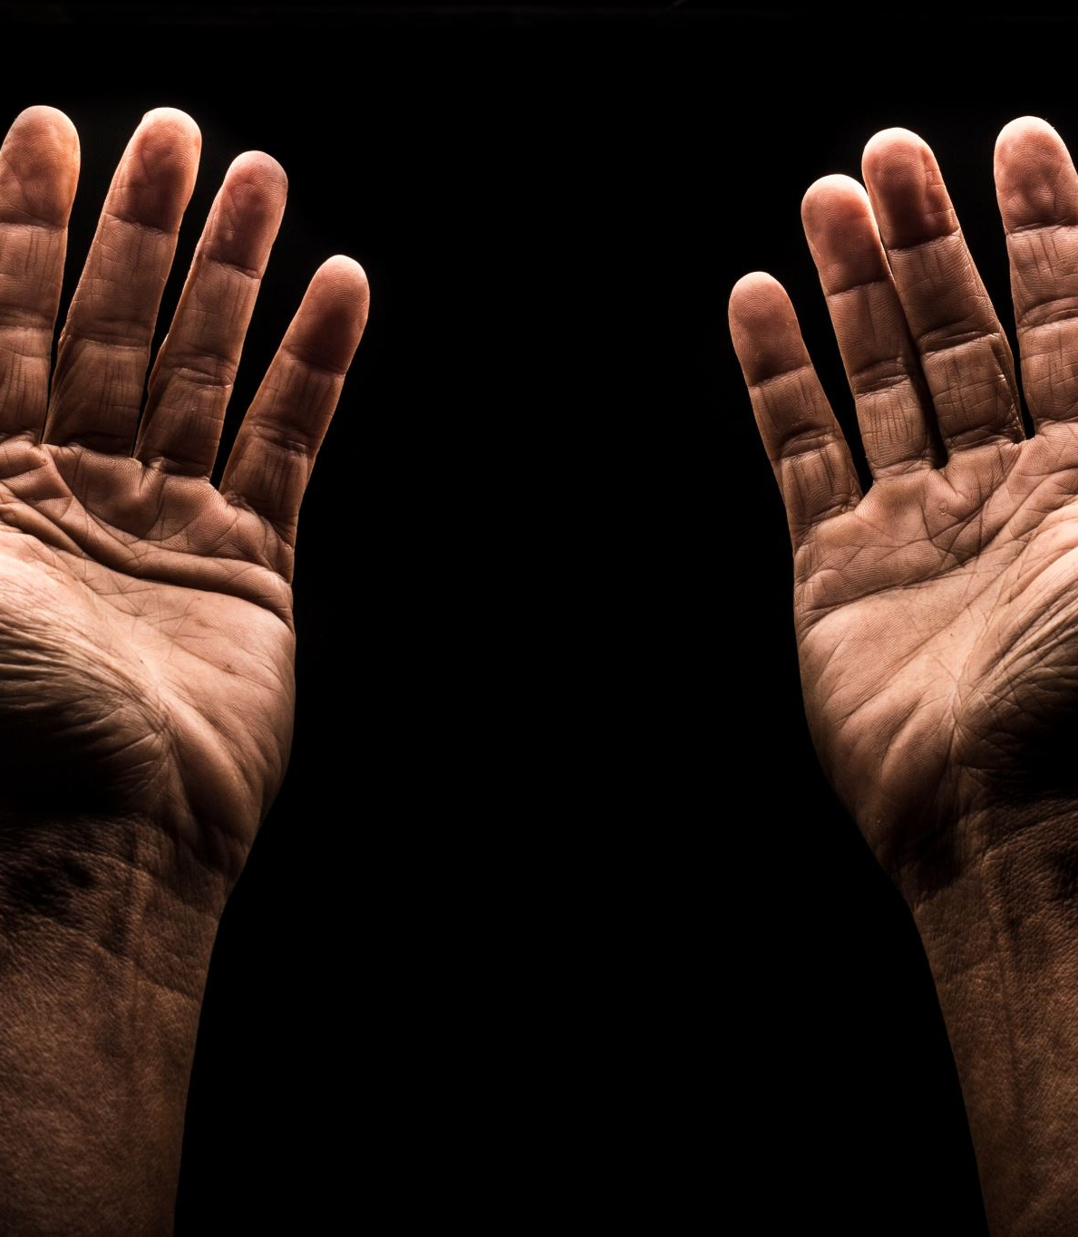
Giving is virtuous, but so accepting gifts gratefully
Notes:
Maybe Christians don’t think enough about this.
Someone can’t give unless someone receives….in most cases.
So if giving is good for our mental health then receiving is a way to facilitate that for someone else; so, receiving is giving!! Hurrah!

Slide 6
Jesus gratefully receives
Matthew 26: 6 – 13
Mark 14: 3 – 9
Luke 7: 36 – 50
John 12: 1 – 8
One of the very few things that appears in EVERY gospel, or at least very similar stories.
Not sure what that means but it seems important.
Notes:
It seems to me that there is something important about the presence of this story (or variants) in all the gospels – not certain what it is, but it feels important.

Slide 7
Perceptual Positions

Slide 8
Perceptual Positions
First Person – How I see things
Second Person – How you see things
Third Person – How someone else would see things
Notes:
Perceptual Positions is a technique drawn from Neurolinguistic Programming. Used in a variety of disciplines to help people develop skills of empathy, by “becoming” the people in a scenario and see the world through their eyes.
Use the version of this story from Mark and become the different people in the scene – see it through their eyes.
How might Jesus’ acceptance of her gift impact on the woman in the story?
What might the impact on another person observing this scene be?
What do we learn about giving and receiving?

Slide 10
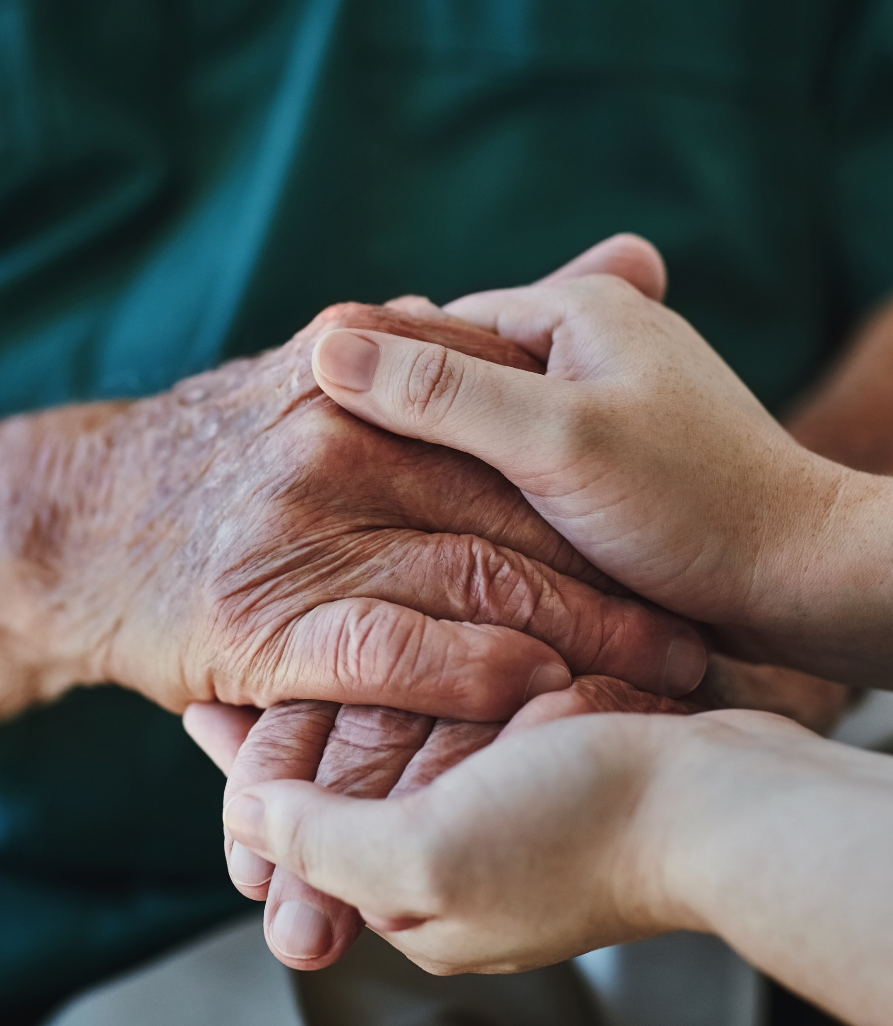
Random Acts of Kindness (Lyubomirsky, 2008)
Large or small
Needs to benefit the other person in some way
Mutual benefit
Particularly effective in improving wellbeing if several acts are carried out in the same day
Important to vary the acts so that they remain fresh and meaningful
Notes:
Familiar to many people but still fun to do, good for us and easy to put into place.

Slide 11
Gratitude visit (Seligman, 2005)
Think of a person you feel grateful to for something that have done for you in the past.
Write them a letter describing what they did and the effect it had on you and your life.
Give them a ring, arrange to meet them, preferably in their house.
When you meet read the letter out loud.
This can could be done by sending the letter, but doesn’t seem to be as effective
Effective for improving mood for up to 6 months – even with clinically depressed people
Notes:
Potentially harder to do but the rewards reported are great for both parties.
Notice that this is effective even for people with a diagnosis of clinical depression.
Reports of this being carried out with American and British students found that the Americans found this easier to do than the British; who felt a lot more embarrassed about it. Strange that.

Slide 12
Questions that I pondered
What is at the heart of giving to others?
How can it be summed up?
Notes:
The rest of this presentation is something we didn’t do on the week although I used some bits elsewhere. Here it is in case some of it is useful.

Slide 13
The Golden Rule
Always treat others as you would
wish to be treated yourself
OR
Do not treat others in a way that
you would not want to be treated

Slide 14
Earliest formulation could be Confucius (around 500 BC)
There are echoes in Egyptian literature several hundred years before that.
This is ancient stuff and Christians weren’t the first to cotton on.
Matthew 7: 12
Jesus is giving a nod to the older Jewish teaching – who in turn probably got it from somewhere else.

Slide 15
But is this an illusion?
Is all charity, compassion, goodness to others really self serving
Is altruism an illusion? Is compassion only skin-deep?
Is this only a way of securing our own gene pool or meeting an internal desire?
BUT
Mencius (circa 300 BC) – “nobody is solely without sympathy for other people” (Armstrong, 2011)
Child on a wall for example
Ancient Greek tragedies for example

Slide 16
Armstrong 2011
“Throughout the centuries, people have found that when they behaved in accordance with Golden Rule, they experienced a deeper, fuller level of existence”

Slide 17
Leviticus 19: 18
You MUST love your neighbour as yourself
Leviticus is a legal text so this implies an obligation
and WHO is my neighbour…………

Slide 18
Matthew 5: 44 - 48
But I say this to you: love your enemies and pray for those who persecute you; in this way you will be children of your father in heaven, for he causes his sun to rise on the bad as well as the good, and his rain to fall on honest and dishonest people alike. For if you love those who love you, what right have you to claim any credit? Even the tax collectors do as much, do they not? And if you save your greetings for your friends, are you doing anything exceptional? Even the pagans do as much, do they not?

Slide 19
Ghandi
“I cannot love Muslims or Hindus and hate Englishmen.
For if I love merely Hindus and Muslims because their ways are on the whole pleasing to me, I shall soon hate them when their ways displease me, as they may well do at any moment.
A love based on the goodness of those whom you love is a mercenary affair”.

Slide 20
A new standard?
Jewish leaders were familiar with Leviticus 19:18 but…
The Old testament has contradictions about this…..both showing love and concern (e.g. Lev 19:33; Ex 23:4; Prov 25:21) and hatred (Psalm 139)
Jesus uses agape in the Matthew extract.
Agape is a choice, a deliberate striving for another’s highest good, and is demonstrated through action.
Luke 6:27 - “love your enemies, do good to those who hate you.”
How might we start to achieve this?

Slide 21
C.S.Lewis
The rule for all of us is perfectly simple. Do not waste your time bothering whether you ‘love’ your neighbour; act as if you did. As soon as we do this we find one of the great secrets. When you are behaving as if you loved someone, you will presently come to love them. If you injure someone you dislike, you will find yourself disliking them more. If you do them a good turn, you will find yourself disliking them less. … The difference between a [Christian] and a worldly man is not that the worldly man has only affections or ‘likings’ and the [Christian] has only ‘charity.’ The worldly man treats certain people kindly because he ‘likes’ them; the [Christian], trying to treat every one kindly, finds themselves liking more and more people as they go on—including people they could not even have imagined themselves liking at the beginning.

Slide 22
Having life to full……………
The more we do the more we get
Perhaps this is the “reward” promised, and not just for some future time but for RIGHT NOW!!

Slide 23
In my life………..
How do I observe the Golden Rule?
What evidence is there of this improving my spiritual wellbeing?
What does this look like and how does it feel?
When do I fail to the follow the Golden Rule?
Are there certain people for whom I find this difficult to follow?

