Slide 1
Compassion as gift
Notes:
Lots of ways we can give to others – sometimes it’s totally of ourselves

Slide 2
Karen Armstrong – Charter for Compassion
https://www.youtube.com/watch?v=SJMm4RAwVLo
Notes:
You tube is really useful – it’s a good way to get great speakers to CPW in a way we could either never afford or never get to……………..
Karen Armstrong is brilliant. I wasn’t sure about whether we should watch all of this – about 20 mins but I thought – yes. It says loads of great stuff, so many quotes – which ones are your favourites?
Thoughts about this?

Slide 3
The Four Immeasurables
Loving kindness: an attitude of friendship for everything and everybody
Compassion: desiring that all be free of pain
Sympathetic joy: wishing joy and happiness for all
Equanimity: putting aside personal attachment and partiality, wishing these things for all
Notes:
I thought we could reflect what other spiritual traditions are saying to us and integrate these into our practice.
As someone on the week said – we’ve spent our time looking at interventions that have been measured scientifically. Nice and refreshing to be thinking about something that is, in some way “immeasurable”. I agree.
What are these elements to this Buddhist practice?

Slide 4
Loving Kindness
Compassion
ME
Sympathetic Joy
Equanimity
Notes:
This must start with ourselves.
We have to wish ourselves peace and happiness before we are equipped to extend that to others. How much do we extend that level of kindness to ourselves?

Slide 5
Matthew 5: 44 - 48
But I say this to you: love your enemies and pray for those who persecute you; in this way you will be children of your father in heaven, for he causes his sun to rise on the bad as well as the good, and his rain to fall on honest and dishonest people alike. For if you love those who love you, what right have you to claim any credit? Even the tax collectors do as much, do they not? And if you save your greetings for your friends, are you doing anything exceptional? Even the pagans do as much, do they not?
Notes:
But we do have examples of this kind of thinking in our sacred texts.
Maybe The Good Samaritan is the greatest story of compassion that we have…..perhaps The Prodigal Son runs it close???
Jesus tells us that we HAVE to extend compassion to those that we find difficult or objectionable.

Slide 6
Ghandi
“I cannot love Muslims or Hindus and hate Englishmen.
For if I love merely Hindus and Muslims because their ways are on the whole pleasing to me, I shall soon hate them when their ways displease me, as they may well do at any moment.
A love based on the goodness of those whom you love is a mercenary affair”.
Notes:
I love a similar kind of teaching from Ghandi.
I also like the fact that he identifies the problem of love becoming a transactional thing. I will give it you if you give it to me – and yet what a very human way to act.

Slide 7
Elizabeth Harris
https://www.bbc.co.uk/sounds/play/p096k0g1
10th February 2021
Notes:
I started putting this presentation together back in the middle of the pandemic. One morning listening to the Today programme I heard this on Thought for the Day. I love the fact that you can find this on BBC Sounds – and loads of others going back years!!
Have a listen.
PS Elizabeth was delivering Thought for the Day on Today Programme again yesterday (3rd Oct 2022) – and she was still talking about the same stuff…..she loves it!!!

Slide 8
Compassion for all exercise
FIRST – start with yourself!!
Next call to mind three people – call them by name.
Imagine them sitting next to you.
Make them vividly present
Someone you like
Someone you neither particularly like or dislike
Someone you dislike
Notes:
Use Elizabeth’s meditation.
Call these people to mind and make them vividly present.
Wish them happiness and peace.
Safety warning – depending on the circumstances of your life this could be difficult and, in some ways, with some people, impossible to do. Perhaps some hurts run too deep at the moment and now’s the wrong time.
That’s fine – this could be a process for anyone – just manage what you can manage and look after your own emotional safety.

Slide 9
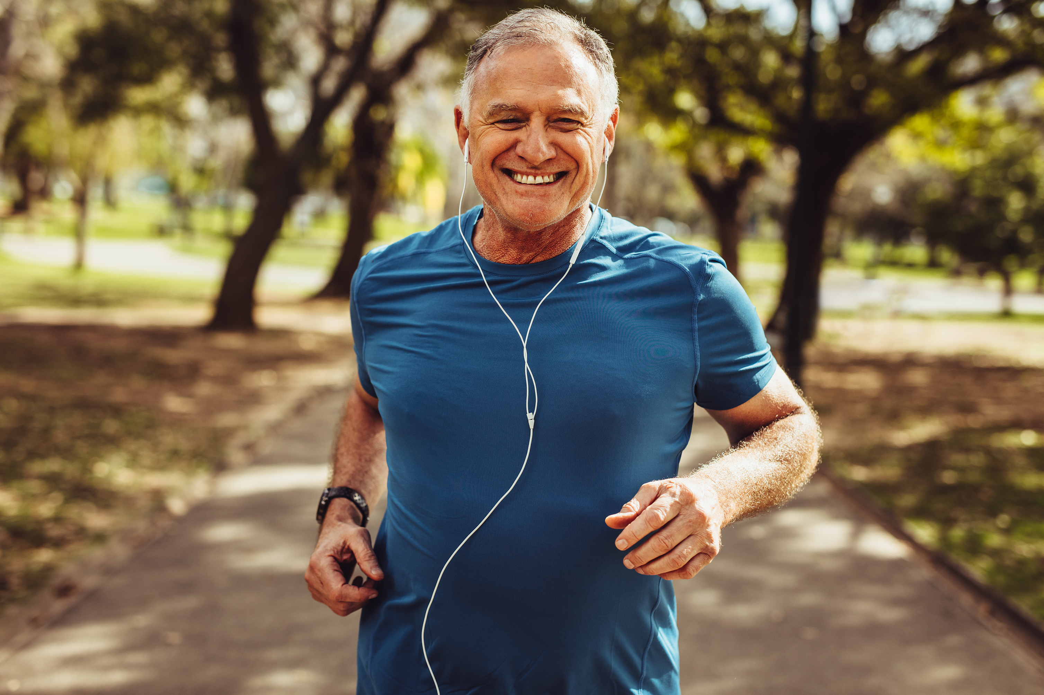
Notes:
This can be done anywhere – walking the dog, taking other forms of exercise, or just while chilling out in the park, although I’m not sure your companion will appreciate your calling others by name – could be embarrassing. In any case, you can do this anywhere.

Slide 10
Loving Kindness
For many love is very partial, because they just love ourselves and our close friends, family members and relatives. However because love is something we can experience quite easily, we can, through practice, push back it’s boundaries.
When you really love, you feel respect for the person who is the object of your love. This attitude of loving-kindness expands and increases by seeing and appreciating their good qualities. True love is based in pure perception and a respectful attitude toward yourself and others.
As soon as you generate an attitude of loving-kindness, you will start feeling more calm and peaceful yourself, and naturally share this feeling with others.
Another power of loving-kindness lies in its ability to overcome serious obstacles. We can see this in the way those at peace with themselves approach the difficulties life throws at them.

Slide 11
Compassion
This is the wish to remove the suffering of all beings.
Compassion helps create an opening or gap in your normal habit patterns and weakens ego-clinging.
You have good reason to feel compassion for others, because every being is suffering. We would all like to be happy all the time, but often, if not constantly, we are facing many difficulties, misfortunes, and hardships.
Most people normally act with good intentions. Even in trivial activities we are trying to achieve some joy, peace, and freedom for ourselves, either directly or indirectly.

