Slide 1
Positive Psychology
Brief Intro and links to the Spiritual Life
Notes:
What is Positive Psychology? Traditional psychology has concerned itself with treating mental illness and has tended to consider how we can improve someone from minus 8 to minus 2 on a sliding mood scale so to speak. Positive psychology has considered how people flourish and how we improve from plus 2 to plus 8 on the same for example.
Why haven’t we studied the ability to flourish – living life to the full if you like.
This presentation was influenced by my attendance at a day retreat given by Roger Dawson SJ (a Jesuit who is also a clinical psychologist) and we will consider a couple of aspects of Positive Psychology and start making the connections with our spiritual wellbeing.

Slide 2
Wellbeing is like Weather
Notes:
Positive Psychology says that wellbeing is a construct with elements that can be recognised and can be measured. A bit like the weather – we can say the weather is good or bad but we measure it by recognising different factors that are measurable. How can we describe wellbeing?

Slide 3
PERMAH
P – positive emotion: the presence of heartfelt positivity
E – engagement: the development of our strengths
R – relationships: the opportunity for genuine connection
M – meaning: the chance to make a positive difference
A – accomplishment: the ability to achieve things that matter
H – health: moving, sleeping and eating well
Notes:
Question: What matters to you most in your life? Post its on flipchart? Does it look like the elements that Positive Psychologists say make up wellbeing.
PERMAH is the currently agreed construct of emotional wellbeing.
It maps very nicely onto the Five Ways to Wellbeing which the week will be built around.

Slide 4
Three Lives
The pleasant life: a life that successfully pursues the positive emotions about the present, past, and future. It’s important to have enjoyable experiences.
The good (engaged) life: developing your signature strengths to obtain abundant gratification (through activities we like doing) in the main areas of your life.
The meaningful life: using your signature strengths and virtues in the service of something much larger than you are. Being connected to something bigger.
Notes:
Positive Psychologists have tried to describe different kinds of lives applying different aspects of the PERMAH model. A life that incorporates more of these dimensions will probably be more fulfilling and therefore lead to greater life satisfaction and wellbeing. A meaningful life being connected to something bigger could well be described by a life of faith although it could also refer to political activism or environmental commitment for example. Or all three in the same life.

Slide 5
Virtues and Strengths (Seligman and Peterson)
Wisdom – creativity, curiosity, judgement, love of learning, perspective
Courage – bravery, persistence, honesty, zest
Humanity – love, kindness, social intelligence
Transcendence – appreciation of beauty, gratitude, hope, humour, spirituality
Justice – teamwork, fairness, leadership
Moderation – forgiveness, modesty, prudence, self-control

Slide 6
Discussion
Discuss your signature strengths
Do you recognise yourself in them?
Do you use them a lot in your life?
When you use them how do you feel?
How do these relate to your spiritual wellbeing?
Notes:
Groups for discussion.

Slide 7
Some thoughts about this
Know your top 5!!!
It makes more sense to build your life around strengths than spend all your time worrying about your weaknesses
When making big decisions ask yourself – will my signature strengths be used?
Use your strengths to solve problems, or help you manage things that cannot be changed.
Look for opportunities to practice these.
Parable of the Talents?
Notes:
Roger Dawson argues that these are God-given gifts and God delights in our use of these. He equates this to the concept of consolation, i.e. when we use these and flourish we are experiencing God in our lives. This seems to be partly what the Parable of the Talents was getting at – perhaps entirely what it was getting at. A Positive Psychologist might wonder why when Christians think about that parable we mostly focus on the “wicked servant” rather than rejoicing in the flourishing of the ones who used their talents. Do we, as Christians, tend to overly focus on our failures or short-comings rather than gain strength and enjoyment from our successes. Perhaps a positive psychology approach could help us here.

Slide 8
FLOW (Csikszentmihalyi, 1975)
Chick – sent – mi – high (Mike to his friends)
being in the zone,
fully immersed in a feeling of energized focus, full involvement, and enjoyment in the process of the activity.
characterized by the complete absorption in what one does, and a resulting transformation in one's sense of time.
Notes:
This concept centres around the experience of being “in the zone”. It often is experienced when we use our signature strengths and can result in total absorption and being “lost in the moment”.
What might create this experience for you?
This often occurs when we are stretched by the task but our ability matches the challenge.

Slide 9
Flow & You
What creates flow experiences for you?
Describe the experience
How do you feel afterwards?
How might flow experiences enhance your spiritual wellbeing?

Slide 10
Some thoughts about Flow
Flow relates to attention
Flow involves a sense of discovery (me, you, the world)
Flow leads to higher states of consciousness
Flow leads to personal growth
Flow is absolutely related to spiritual health
Flow engages our whole self, the activity is meaningful and associated with positive emotion.
We should look for these experiences, we should manufacture them
Flow experiences are most likely related to our Signature Strengths.
Notes:
One might say that the loss of oneself in the experience is akin to coming into contact with that which is divine in our lives. A gardener who loses all track of time while tending their patch of earth is in touch with God during that experience. Similarly with a musician, a swimmer, a mathematician, someone at prayer etc etc.

Slide 11
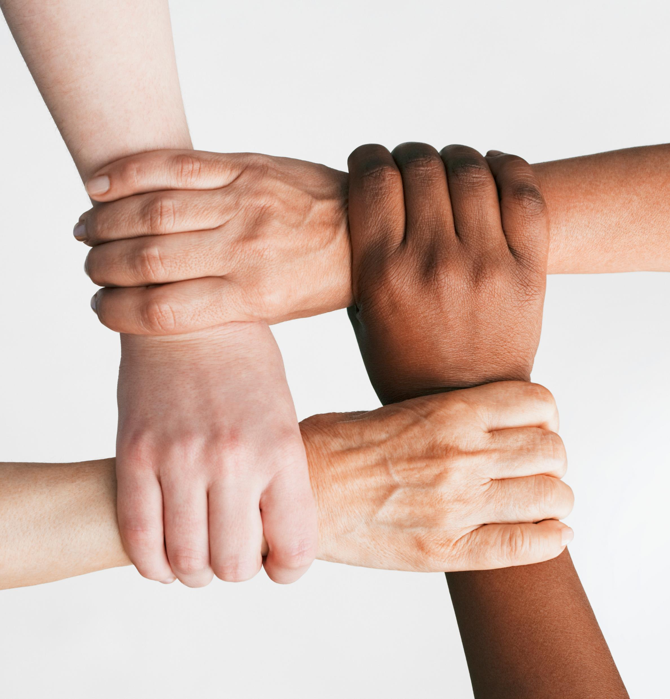
Quick intro to Positive Psychology – Recap Wellbeing is measurable; Use of Signature Strengths leads to experiences of Flow; God delighting and God connecting?
Notes:
Recap – Positive Psychology can help us focus on that which causes us to flourish.
Wellbeing can be broken down into measurable parts (PERMAH) which resonate nicely with the Five Ways to Wellbeing.
Use of our Signature Strengths that can generate experiences of Flow bring us into contact with God. We should try to do as much of this as possible in our lives, and then we really will live life to the full.

