Slide 1
Life to the Full
John 10:10
Notes:
Why did I use this title? The context refers to Jesus as the Good Shepherd and perhaps what you can expect from him as opposed to the “thief” who only comes to “kill and destroy”. In recent years, with all the work I’ve done in the field of mental health and workplace wellbeing somehow it feels like there may be more to this for me – this is what this week is trying find out about/think about/explore.

Slide 2
Notes:
Why are we all here – ice breaker. Three reasons why you’re here.

Slide 3
Why am I interested?
Mental health social worker
Workplace wellbeing
A person of faith with dodgy self image
A rubbish Christian?
Solutions or strategies?
Notes:
Thought about chairing a CPW for some time (Dad’s fault I think). This is the only thing I could do with any proper conviction since my professional life has surrounded this stuff. My view of myself also feeds in greatly. This week won’t be so much about finding solutions to our spiritual ills or problems – more about coping strategies and finding space to talk about this. If you do find any solutions though share them – we could all do with a few.

Slide 4
What is spiritual wellbeing?
Spiritual wellbeing is a deeply personal dimension of wellbeing, and can mean something different to everyone.
relates to our sense of life-meaning and purpose
connection to culture, community, spirituality and/or religiosity
includes the beliefs, values, mental models and ethics we hold.
Teach in the Territory (2018)
Notes:
This week will touch on matters of mental health from time to time but it’s really about wellbeing rather than anything to do with diagnosis – although the 2 do relate to each other.
Spiritual wellbeing – what is that?
Relates to the things we believe about the world around us including but not not exclusively religious belief. It relates to our ideas about things and people and what we think is right. So our faith is crucial here but not the only influencer in our lives.

Slide 5
What does this mean?
Do I recognise those elements of Spiritual Wellbeing in my life?
What would be happening in our lives if we had positive Spiritual Wellbeing; what would it feel like?
How does my religious faith life contribute to this?
How does my religious faith life get in the way?
Religious faith can include experience of Church
Notes:
Small groups
Think about how your religious life might enhance AND diminish your spiritual wellbeing.

Slide 6
What’s in your Stress Font?
Notes:
Stress bucket analogy (find out more about this at this link: https://mentalhealthathome.org/2021/03/12/what-is-stress-bucket/)
What are the aspects of your faith life that might be like water going into your stress font?
People brought a stone which represented this stress and put it in a basket which stayed with us all week. The stones got used for a variety of things, mostly weighing things down so they didn’t blow away – felt quite appropriate really.
During the week we will look at ways to think about how we empty this, or at least keep it in check.

Slide 7
Five Ways to Wellbeing
New Economics Foundation (2008)
Previous assumption – people who aren’t ill are well.
Does this fit with our experience?
How might we prevent people becoming unwell?
A public health approach
Just because a person is not mentally unwell does not mean that their wellbeing is good.
Set out to create the mental health equivalent of “five a day”
Notes:
How do we start to empty our stress font/bucket?
Five Ways to Wellbeing – New Economics Foundation (2008): prior to this time people tended to think about mental health or mental ill health. My experience of teaching people about mental health was that mental health equated to mental illness – a disease model. Actually this didn’t really chime with people’s experience. Many people think of this like a continuum now and in fact many (most) people with mental health problems are recovering and enjoy good wellbeing much of the time – but perhaps not always.
Mental Health continuum (find out more at this link: https://mental-health-matters.org/about-mental-health/attitudes-to-mh-issues/the-mental-health-continuum/)
Small groups - experiences of wellbeing vs mental health.
The next few slides show the Five Ways to Wellbeing.

Slide 8
Connect with others
With the people around you.
With family, friends, colleagues and neighbours.
At home, work, school or in your local community.
Think of these as the cornerstones of your life and invest time in developing them.
Building these connections will support and enrich you every day.

Slide 9
Notice
Be curious.
Catch sight of the beautiful. Remark on the unusual. Notice the changing seasons.
Savour the moment, whether you are walking to work, eating lunch or talking to friends.
Be aware of the world around you and what you are feeling.
Reflecting on your experiences will help you appreciate what matters to you.

Slide 10
Give to others
Do something nice for a friend, or a stranger.
Thank someone. Smile.
Volunteer your time. Join a community group.
Look out, as well as in.
Seeing yourself, and your happiness, linked to the wider community can be incredibly rewarding and creates connections with the people around you.

Slide 11
Keep Learning
Try something new.
Rediscover an old interest.
Sign up for that course.
Take on a different responsibility at work.
Fix a bike. Learn to play an instrument or how to cook your favourite food.
Set a challenge you will enjoy achieving.
Learning new things will make you more confident as well as being fun.

Slide 12
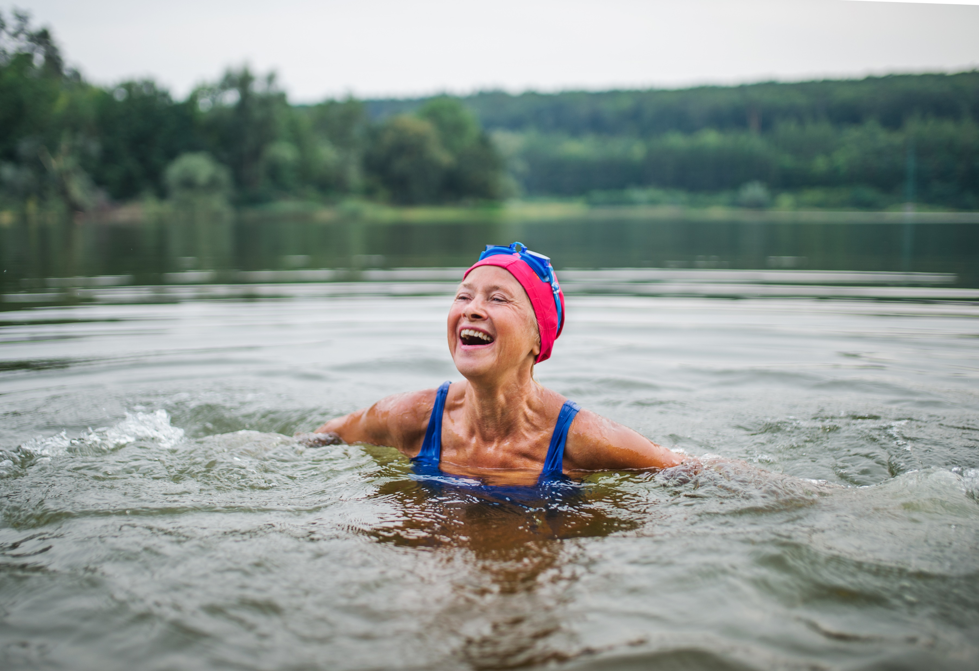
Stay Active
Go for a walk or run.
Step outside.
Cycle.
Play a game.
Garden.
Dance.
Exercising makes you feel good.
Most importantly, discover a physical activity you enjoy and that suits your level of mobility and fitness.
Other ways to be active?

Slide 13
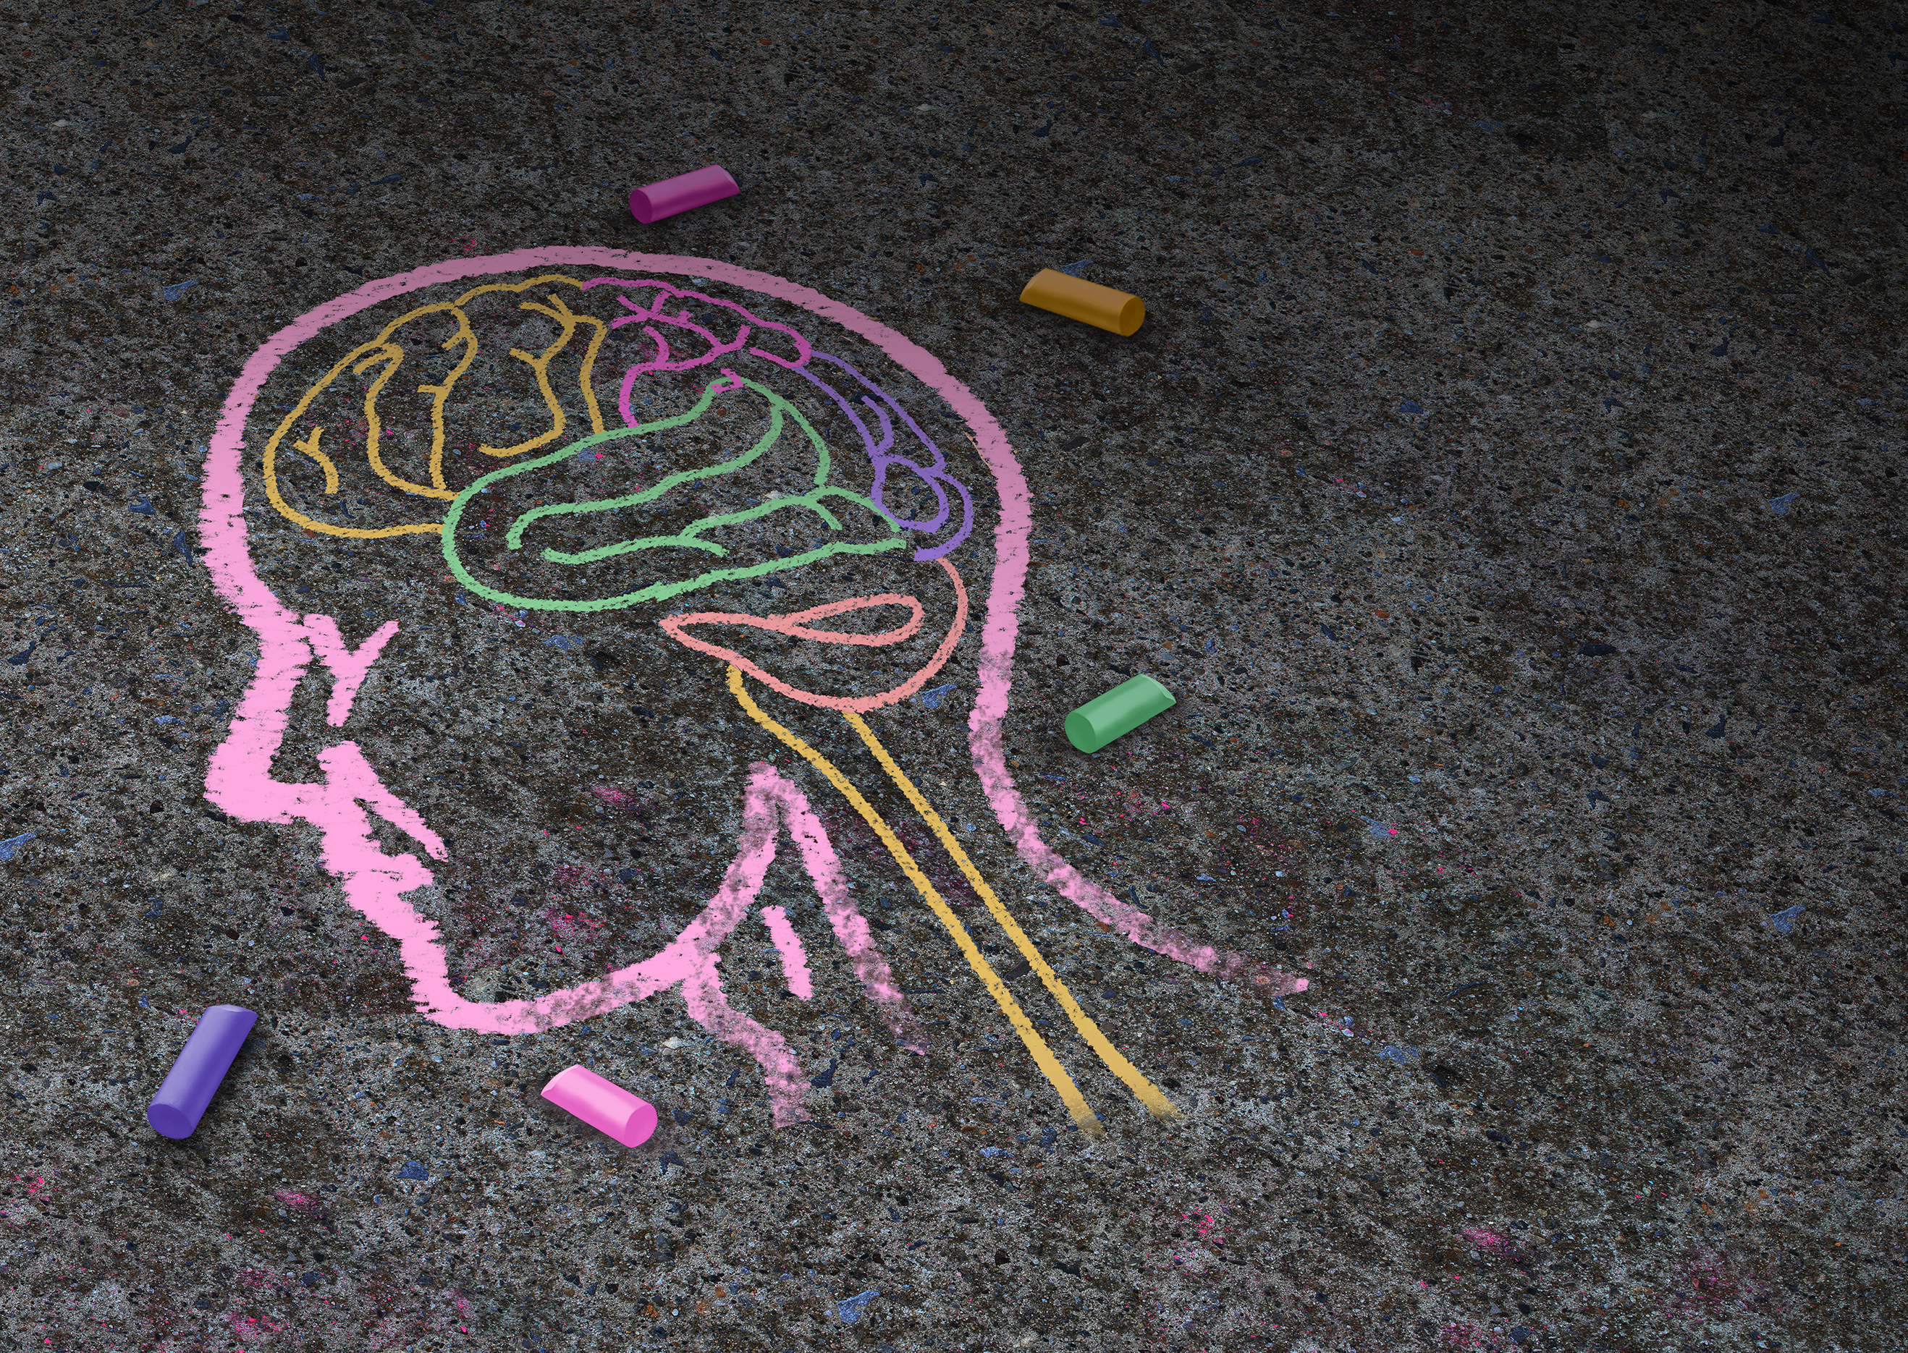
“The Five Ways are like DNA – simple but elegantly effective. They sit at the heart of things”.
“The Five Ways are relevant to anyone who wishes to take action to improve their quality of life…..if people experience [their] value, they are more likely to understand and value the messages and pass them on….”
“If you don’t have it, how can you give it?”

Slide 14
Solutions or strategies?
Notes:
This week is about strategies much more than solutions.
If you find solutions to everything in the stress font share them out but I’m not very optimistic about that . I AM optimistic about strategies and sharing them. Some of you will already have them – let EVERYONE know.

Slide 15
Spiritual Fitness exercises
Contemplation
Spending time in nature
Non judgement
Regular acts of compassion
Reading uplifting books
Silence
Letting go
Prayer
Yoga, T’ai Chi etc
Chanting
Notes:
Things we’ll do this week that might help.
Looking forward to the chanting

Slide 16
 | Sat | Sun | Mon | Tues | Wed | Thur | Fri | Sat
AM |  | Intro: Spiritual Wellbeing | Connection: Connecting self, others and God | Noticing the world: Genny and trees and other stuff | FREE DAY | Give: Giving is good for us | CPW Charity What has made a difference? | Is there anything to be said for another Mass?
Free Time | Mass
 | Staying Active
PM | Welcome | Positive Psychology: Relevant to our faith? | Connection: Mutuality with Rachel | Noticing our lives: Savouring | Learning from each other | Give: Compassion as gift | CONCERT
 | NIGHT PRAYER
Evening | Cheese and Whine | Games | Quiz |  | Pictionary | Night Hike
Notes:
Here’s the plan for the week.

